Slide 1



Submit:
Yossi Elias, Roee Tal, Tahel Zecharia

Slide 2

Problem Space:
Some people don't know places to travel and don't know where to look for a suitable place.
People want to know new places.
People want to search for a trip according to any preferences
People want to check if a specific place is recommended according to current recommendations
people need community. when travel with new people they get to know each other better and they expand their social circle.

Slide 3
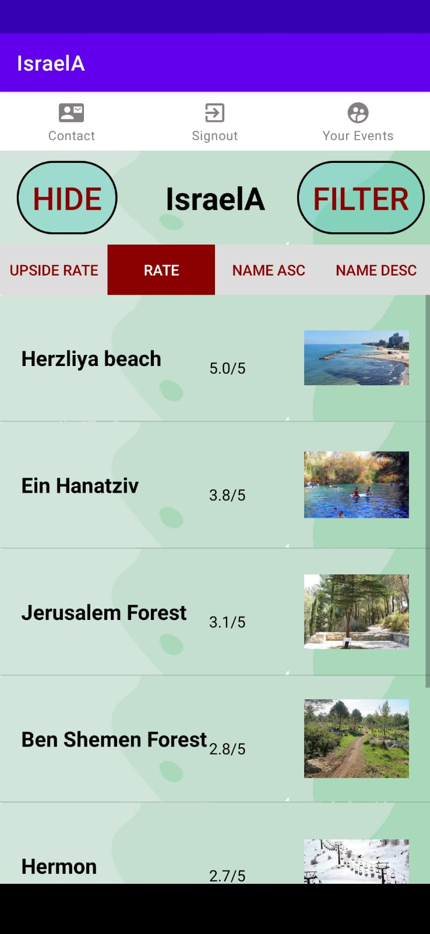
Problem Space:
Existing Solutions:
עמוד ענן - אפליקציה
טיולי
What We Do Better:
Community trips
Contact the manager
Adding personal rating and opinion
Simple and intuitive UI

Slide 4
Project Goals:
Making the information about travel sites accessible to people who don't usually travel or to people who want to get to know new places.
Searching for a specific site and viewing its rating and comments.
Search for a site according to personal preferences
Joining an organized group trip.

Slide 5
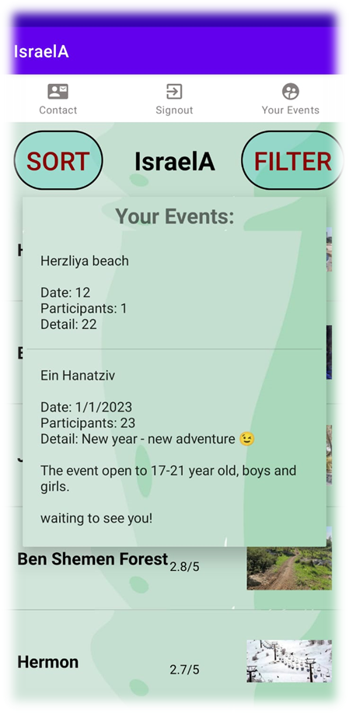
Requirements:
Manager:
Managing the data about the itineraries (functional)
Organization of a group trip (functional)
Permission to remove users who behave offensively (functional)
User:
Search for a suitable trip with the possibility of relevant filters (functional)
Adding an opinion on the place of the trip (functional)
Intuitive screens for the average user (usability)
Option to contact the manager (reliability)
General:
Catching runtime errors. (reliability)
Security – connect only with private password or Google account (security)

Slide 6
Main Features:
User:
viewing all existing sites
filtering according to preference
viewing the details of a desired site
adding a comment and rating
contacting the manager
join organized trip
watching register trip.
Manager:
editing the sites
adding new sites
removing users
organizing trips
upload photos
responding to messages from users using direct connect to gmail
General:
login through different permissions
navigate through the menu bar.

Slide 7
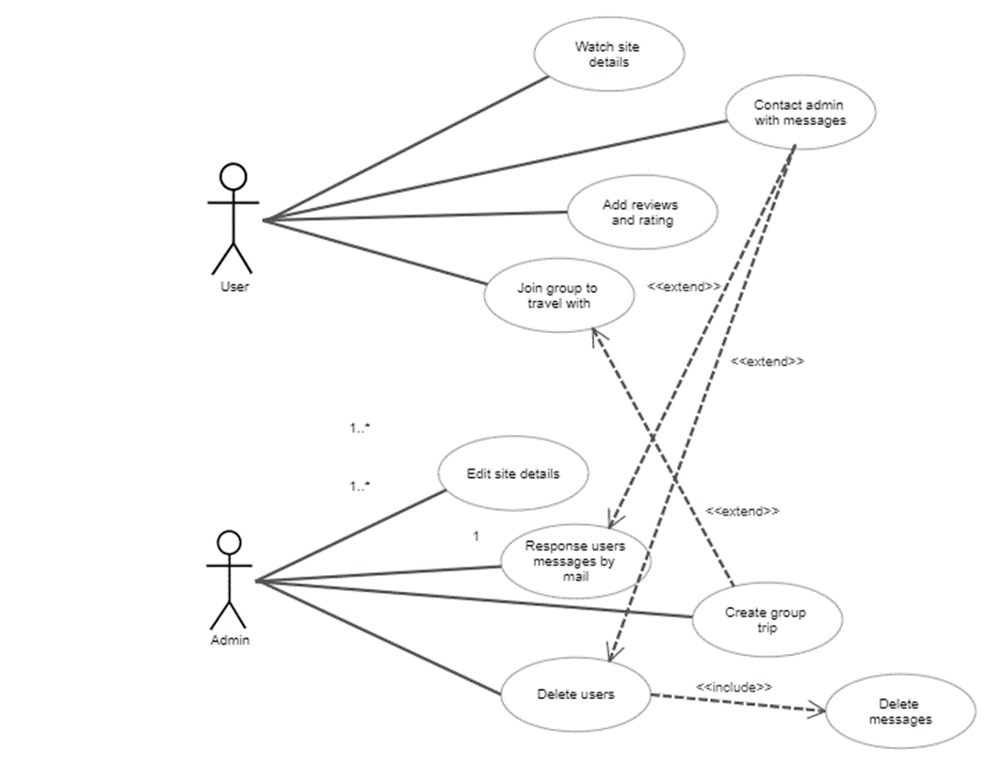
Selected UML diagrams:
Use-Case Diagram

Slide 8
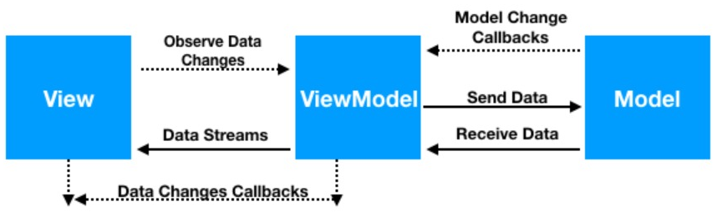
System Structure And Tiers:
Firebase: Firebase auth, firestore and storage .
Node.js: in order to create the app server.
We used the MVVM pattern.
View: all the xml and activity files while the activity files has only view.
ViewModel: communicates with the view when some change is needed, and with the model to send and receive data from the database.
Model: responsible for all the logics in the database. Communicates with the view model. Includes the connection to the app server and the objects.

Slide 9
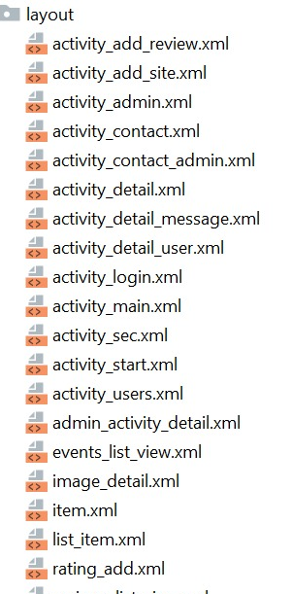
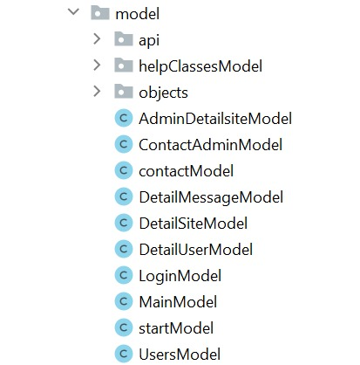
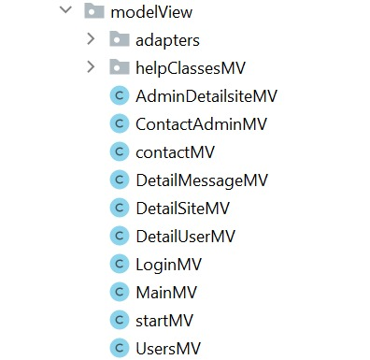
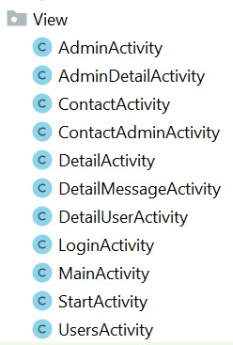
System Structure And Tiers:
View
Model
Model View

Slide 10
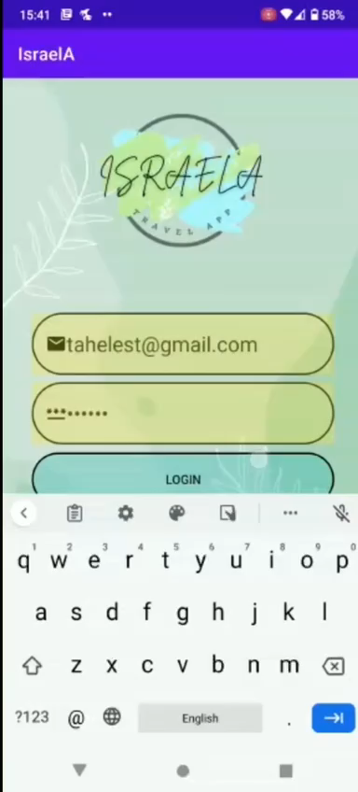
System description - User

Slide 11
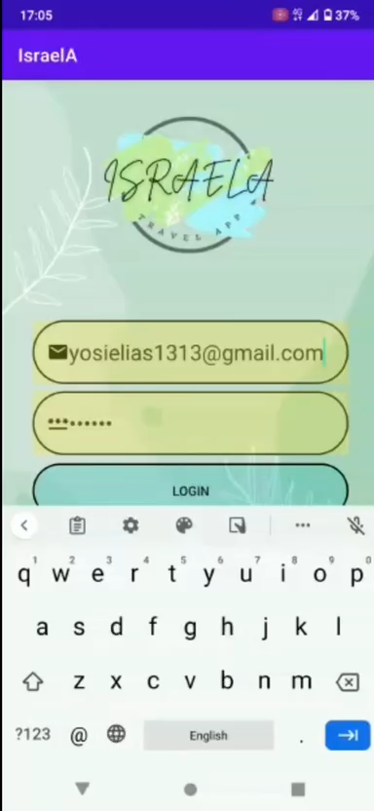
System description - Manager

Slide 12
Gaps and challenges
Option to navigate to the destination from current location (via waze or google map).
Password recovery option.
Facing new language(javaScript).
Organizing the code.
Agile practice.

Slide 13
Git Link
https://github.com/YosiElias/SE_project-

